Slide 1

Geometry
Unit 10, Lesson 4 Solving Problems Using Arc Length and Area of a Sector Volume 2, pg. 135

Slide 2


Benchmark
MA.912.GR.6.4
Solve mathematical and real-world problems involving the arc length and area of a sector in a given circle.
volume 2, pg. 135

Slide 3
Integrated Mathematical Thinking and Reasoning Standards
MA.K12.MTR.1.1 Actively participate in effortful learning both individually and collectively.
MA.K12.MTR.2.1 Demonstrate understanding by representing problems in multiple ways.
MA.K12.MTR.4.1 Engage in discussions that reflect on the mathematical thinking of self and others.
MA.K12.MTR.5.1 Use patterns and structure to help understand and connect mathematical concepts.
volume 2, pg. 135

Slide 4

Learning Target
I can solve mathematical and real-world problems involving arc length and sector area.
volume 2, pg. 135

Slide 5

Warm-Up
volume 2, pg. 135

Slide 6
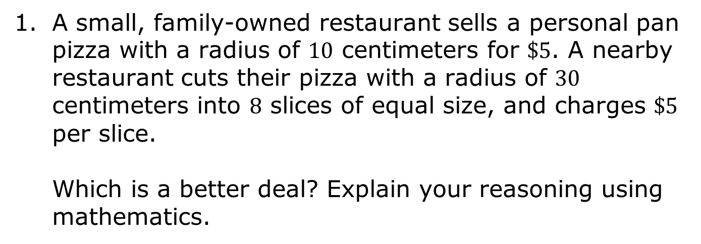
10.4.1 Warm-Up: Bell Work
volume 2, pg. 135

Slide 7

Exploration
volume 2, pg. 136

Slide 8

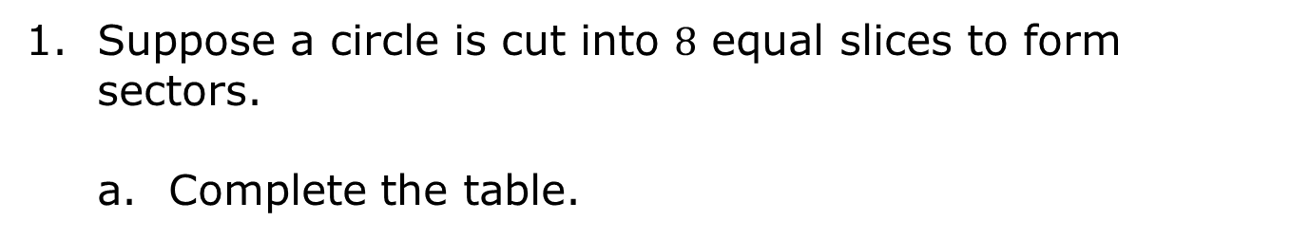
10.4.2 Exploration: Finding a Formula for the Area of a Sector
Number of Slices | Fraction of the Circle | Central Angle in Degrees (°) | Write an Equation to Find the Area of the Sector
2
4
6
8
volume 2, pg. 136

Slide 9

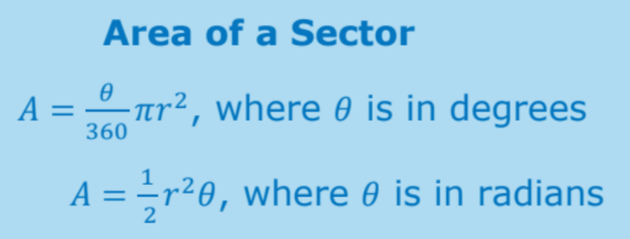
Compare the values in your table with your partner. Discuss your equations in the last column and make any revisions if needed.
c. Discuss with your partner how the fractions in your equations relate to the central angles, and how the equations might have differed if the angle measure was given in radians.
d. Summarize your discussion by writing a general formula to find the area of any sector.
volume 2, pg. 136

Slide 10

Guided Practice
volume 2, pg. 137

Slide 11

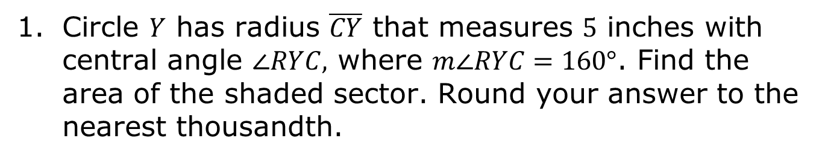
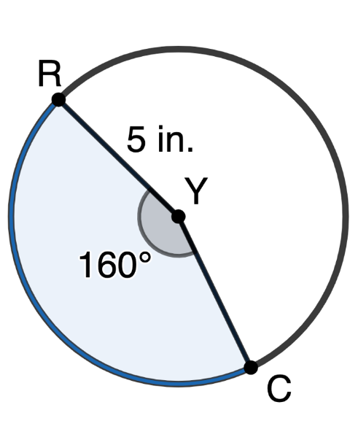
10.4.3 Guided Practice: Area of a Sector
volume 2, pg. 137

Slide 12
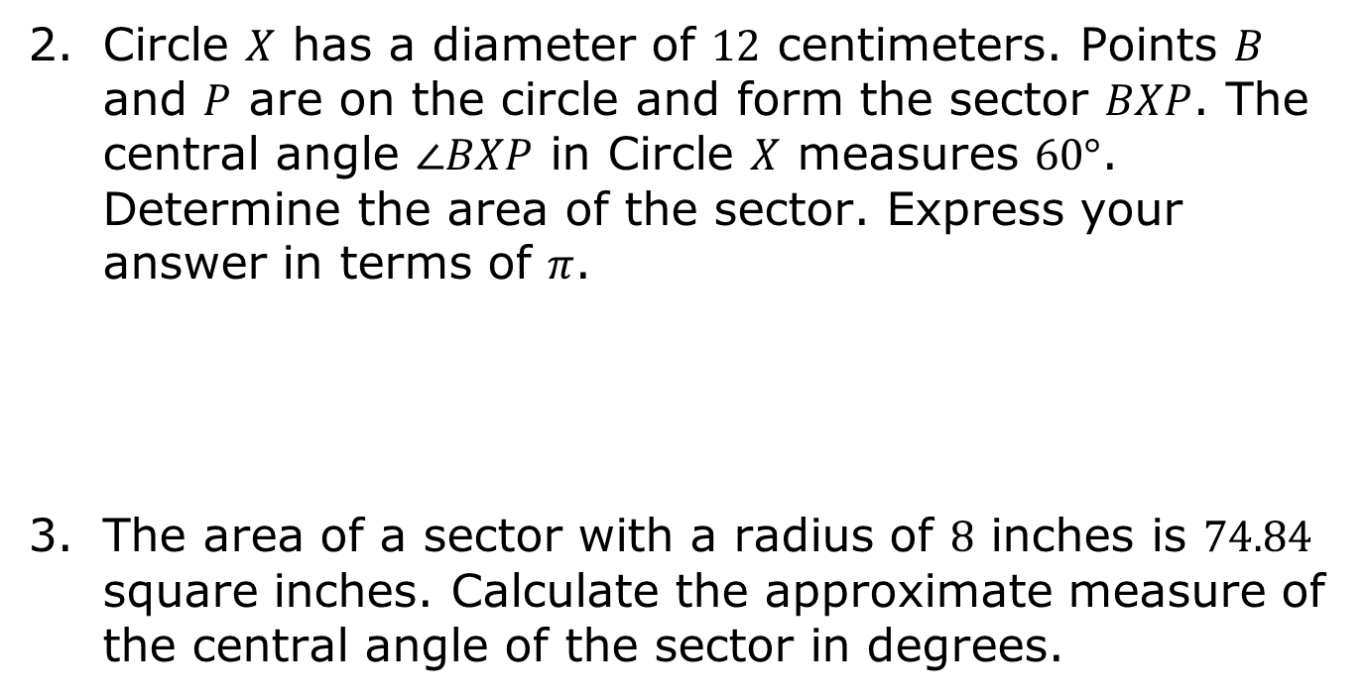
volume 2, pg. 137

Slide 13

Collaboration
volume 2, pg. 137

Slide 14

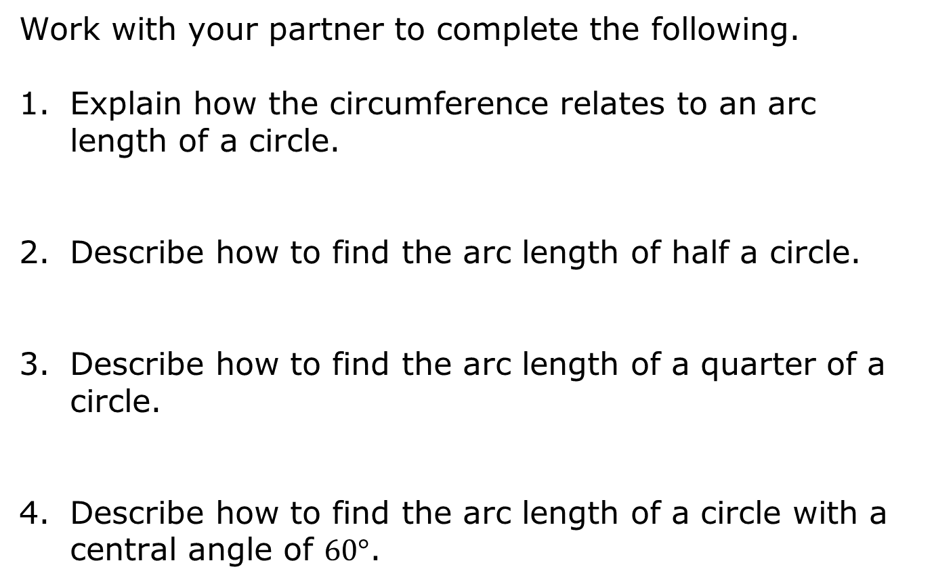
10.4.4 Collaboration: Arc Length
volume 2, pg. 137

Slide 15
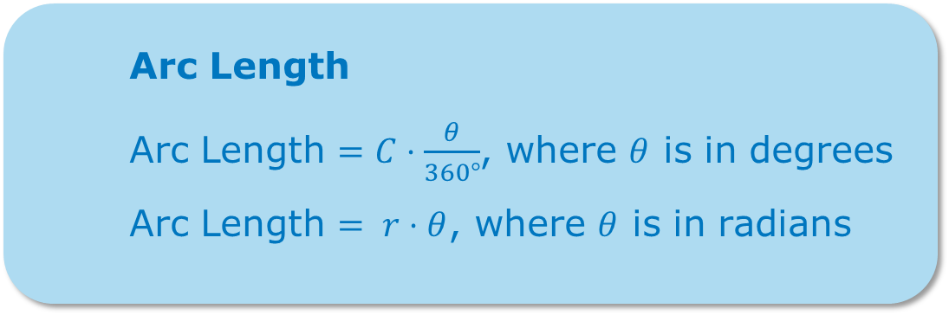
Write a general equation that can be used to find the arc length of a sector in degrees.
Discuss with your partner how your equation would change if the central angle had been given in radians. Summarize your discussion by writing an equation to find the arc length if the angle measure is given in radians.
volume 2, pg. 138

Slide 16
Guided Practice
volume 2, pg. 138

Slide 17
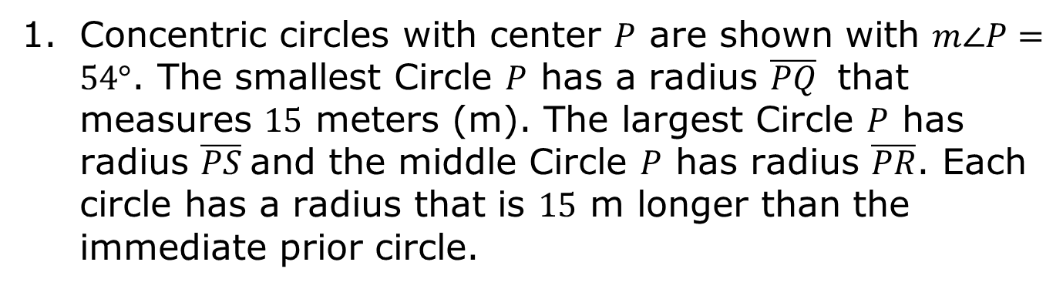
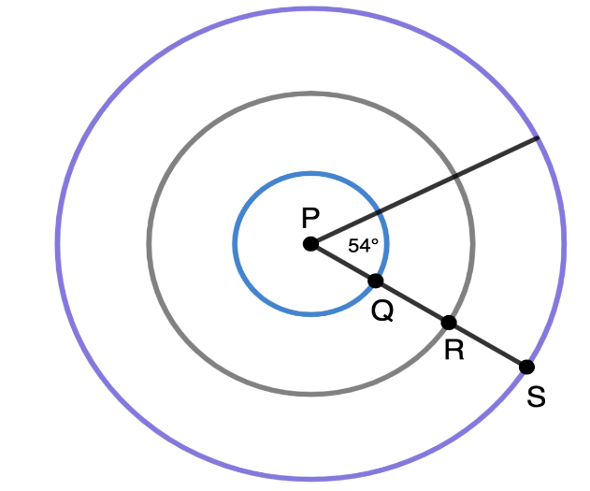
10.4.5 Guided Practice: Arc Length
volume 2, pg. 138

Slide 18

Arc length of circle with radius PQ
Arc length of circle with radius PR
Arc length of circle with radius PS
volume 2, pg. 138

Slide 19
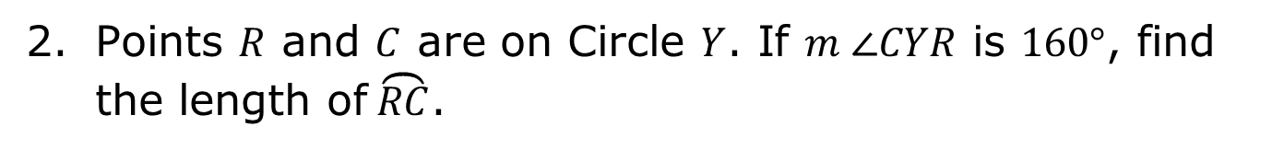
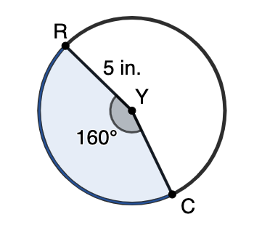
volume 2, pg. 139

Slide 20
Guided Practice
volume 2, pg. 139

Slide 21
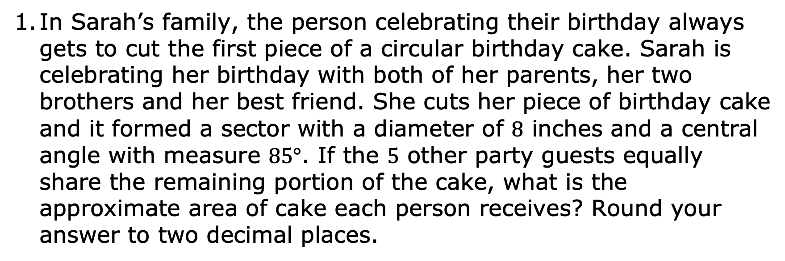
10.4.6 Guided Practice: Solving Real-World Problems Involving Arc Length and Area of a Sector
In Sarah’s family, the person celebrating their birthday always gets to cut the first piece of a circular birthday cake. Sarah is celebrating her birthday with both of her parents, her two brothers and her best friend. She cuts her piece of birthday cake and it formed a sector with a diameter of $8$ inches and a central angle with measure $85°$. If the $5$ other party guests equally share the remaining portion of the cake, what is the approximate area of cake each person receives? Round your answer to two decimal places.
volume 2, pg. 139

Slide 22
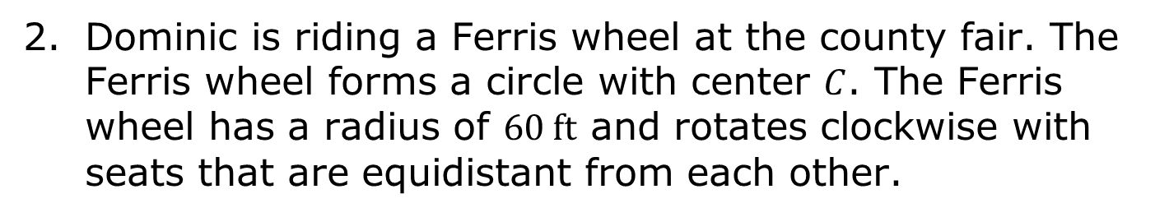
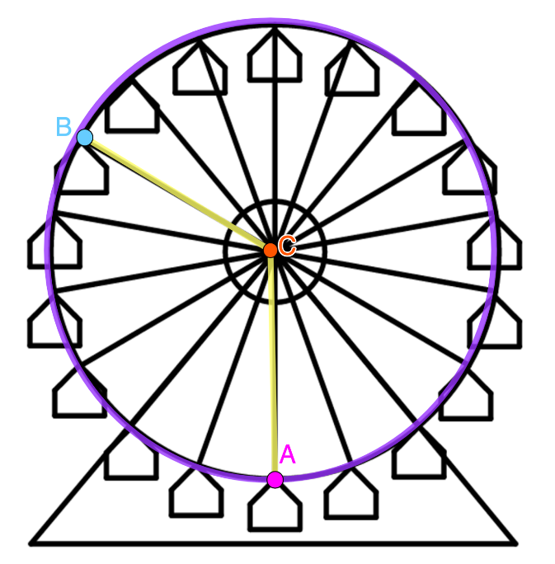
volume 2, pg. 140

Slide 23
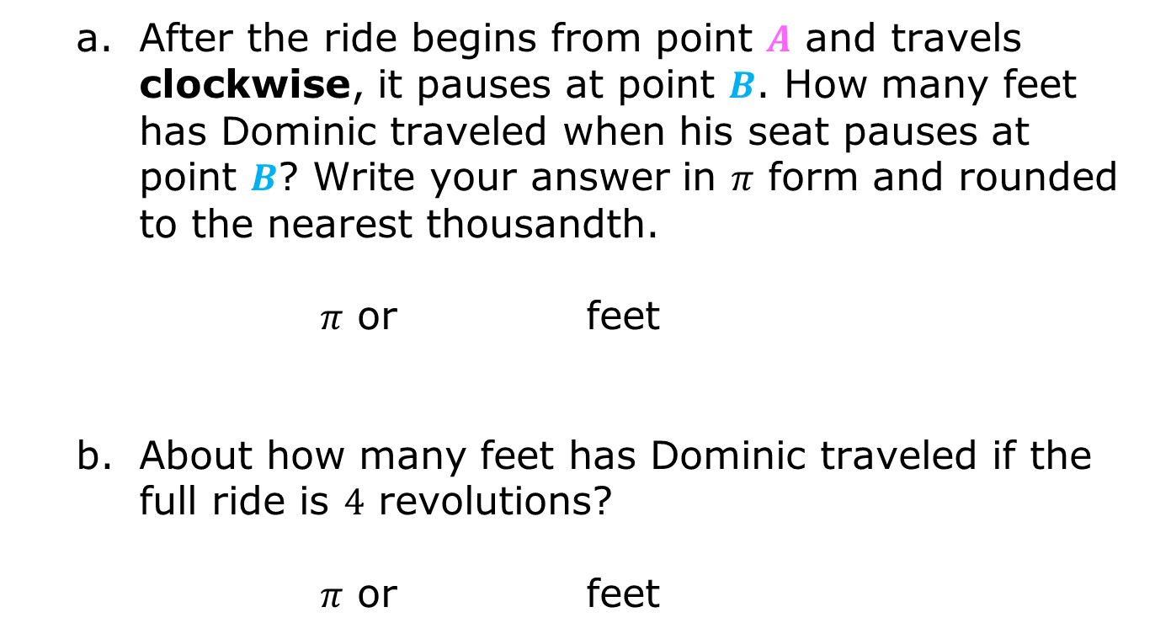
volume 2, pg. 140

Slide 24

Wrap-Up
volume 2, pg. 140

Slide 25
10.4.7 Wrap-Up: Cool Down
Write a summary of what you learned in this lesson.
volume 2, pg. 140

